Slide 1
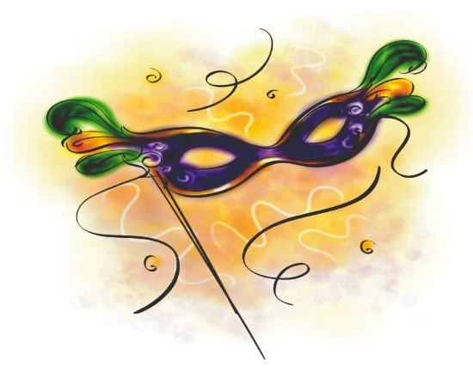
Homecoming Dance
Junipero Serra High School proudly presents
“Bourbon Street Masquerade Homecoming Dance” which will be held at the Concourse Hotel at LAX.
6225 West Century Blvd
Los Angeles, CA 90045
Doors open at 8:00pm and close at 9:00pm
Semi-Formal
September 27th, 2014
Tickets are forty-five dollars per person from Thursday, September to Friday, September 19th . After September 19th, tickets are fifty-five dollars per person. Tickets can be purchased in the Main Office. All guests must have a signed guest contract.

